Slide 1
Is telemedicine a realistic way of providing medical care?
Enda Rice

Slide 2
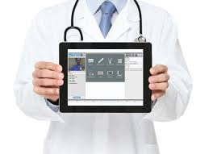

What is Telemedicine?
Telemedicine is the use of information technology to help provide medical care at a distance to patients.
Telemedicine includes a growing variety of applications and services using two-way video, email, smart phones, wireless tools and other forms of telecommunications technology.

Slide 3
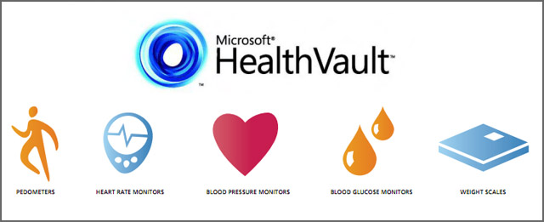
Example of Successful Telemedicine Provider.
Microsoft HealthVault: https://www.healthvault.com/ie/en
Leading Provider of Telemedicine.
Puts the user in control of their own medical information

Slide 4

Example of Failed Telemedicine Provider.
Google Health:
https://www.google.com/intl/en_us/health/about/
Discontinued on the 1st of January 2013
Didn’t scale up as planned and was only
adopted by the tech savvy and fitness
enthusiasts

Slide 5
What are the Advantages and Disadvantages of Telemedicine?
Advantages:
Disadvantages:
Improved Access
Cost
Improved Quality
Patient Demand
Speed (Internet Based)
Patient/Doctor Relationship
Digital Divide

Slide 6
Services Provided by Telemedicine.
Primary care and specialist referral services
Remote patient monitoring
Consumer medical and health information
Electronic Health Records (EHR’s)

Slide 7
Future of Telemedicine
Telemedicine is still an emerging service.
The Global Telemedicine market in 2016 is predicted to be $27 billion, with Virtual Health Services making up $16 billion of that amount (BBC Research and Towers Watson).
By 2018, 65 percent of interactions with healthcare organizations will be done via mobile devices, and by 2018 70 percent of them will have apps, offer wearables, do remote health monitoring, and even offer virtual care (IDC).
More than one-third of the money Google Ventures invested in 2014 went to healthcare and life-sciences companies.

Slide 8
Any Questions?
THANK YOU

